Slide 1
Advanced Databases
M. K. Valvi
Suchitra Patil

Slide 2
Data Lake

Slide 3

“If you think of a Data Mart as a store of bottled water, cleansed and packaged and structured for easy consumption, the Data Lake is a large body of water in a more natural state. The contents of the Data Lake stream in from a source to fill the lake, and various users of the lake can come to examine, dive in, or take samples.”
- James Dixon, founder and former CTO of Pentaho

Slide 4
What is a Data Lake?
A data lake is a central location that handles a massive volume of data in its native, raw format and organizes large volumes of highly diverse data. Whether data is structured, unstructured, or semi-structured, it is loaded and stored as-is. Usually blobs or files
Compared to a hierarchical data warehouse that saves data in files or folders, a data lake uses a flat architecture to store it
A data lake is usually a single store of data including raw copies of source system data, sensor data, social data etc., and transformed data used for tasks such as reporting, visualization, advanced analytics and machine learning

Slide 5
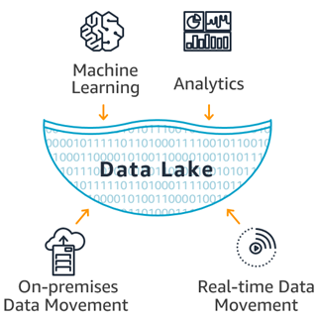
What is a Data Lake?

Slide 6
Before Data Lake
Relational Database
Simple, Reliable
Highly Structured Data
Not suitable for big data
Rise of Internet
Large volume of data
Multiple Databases
Data Silos
Data Warehouse
Collection of relational databases under a single umbrella
With time became available in the cloud
Integrated Data ready for analytical queries

Slide 7
Before Data Lake
Data Warehouse downsides
Inability to store unstructured, raw data
Expensive, proprietary hardware and software
Difficulty scaling due to the tight coupling of storage and compute power
Apache HADOOP™
a collection of open source software for big data analytics
capability to analyse raw data, structured, semi-structured and unstructured
Issues of collecting and storing this data led to modern Data Lake

Slide 8
Data Warehouse & Data Lake
Characteristics | Data Warehouse | Date Lake
Data | Relational from transactional systems, operational databases, and line of business applications | Non-relational and relational from IoT devices, web sites, mobile apps, social media, and corporate applications
Schema | Designed prior to the DW implementation (schema-on-write) | Written at the time of analysis (schema-on-read)

Slide 9
Data Warehouse & Data Lake
Characteristics | Data Warehouse | Date Lake
Price / Performance | Fastest query results using higher cost storage | Query results getting faster using low-cost storage
Data Quality | Highly curated data that serves as the central version of the truth | Any data that may or may not be curated (ie. raw data)

Slide 10
Data Warehouse & Data Lake
Characteristics | Data Warehouse | Date Lake
Analytics | Batch reporting, BI and visualizations | Machine Learning, Predictive analytics, data discovery and profiling
Users | Business analysts | Data scientists, Data developers, and Business analysts (using curated data)

Slide 11
Analysis Paradigms
Application Database | Data Warehouse | Date Lake
Relational Data Structuring Ingest Data Analyze | Report Data Structuring Ingest Data Analyze | Ingest Data Analyze Define Data Structure

Slide 12
Advantages of Developing a Data Lake
Ability to collect all types of structured and unstructured data in a data lake
More flexibility
Ability to store raw data—you can refine it as your understanding and insight improves
Unlimited ways to query the data
Application of a variety of tools to gain insight into what the data means
Ability to derive value from all types of data
Elimination of data silos
Democratized access to information via a unique, centralized view of data across the organization
Notes:
In a data lake architecture, data is stored in its raw format without any predefined structure, allowing users to query and analyze the data in various ways based on their specific needs and requirements.
A data silo is a repository of data that's controlled by one department or business unit and isolated from the rest of an organization, much like grass and grain in a farm silo are closed off from outside elements. ( in DW it is realted to one process only) Data democratization is the process of making data more accessible to employees within an organization, regardless of their technical expertise. The purpose of data democratization is to give more people the ability to access and analyze data to make decisions with less effort from the data team.

Slide 13
Data Lake Architecture
The architecture of a data lake refers to the features that are included within a data lake to make it easier to work with that data
Even though data lakes are unstructured, it is still important to ensure that they offer the functionality and design features that your organization requires in order to easily interact with the data that they house
A data lake should present three key characteristics
A single shared repository of data
Includes orchestration and job scheduling capabilities
Has a collection of workflows to execute

Slide 14
Data Lake Architecture
Various types of sources for data
Operational data
sales, finances, inventory etc.
Auto-generated data
IoT devices, logs etc.
Human-generated data
social media posts, emails, web content etc. either coming from inside, or from outside the organization.
All data stored in native format

Slide 15
Data Lake Architecture
Though Data Lake is single repository, for flexibility it can be divided in following layers
Raw
Standardized
Cleansed
Application
Sandbox

Slide 16
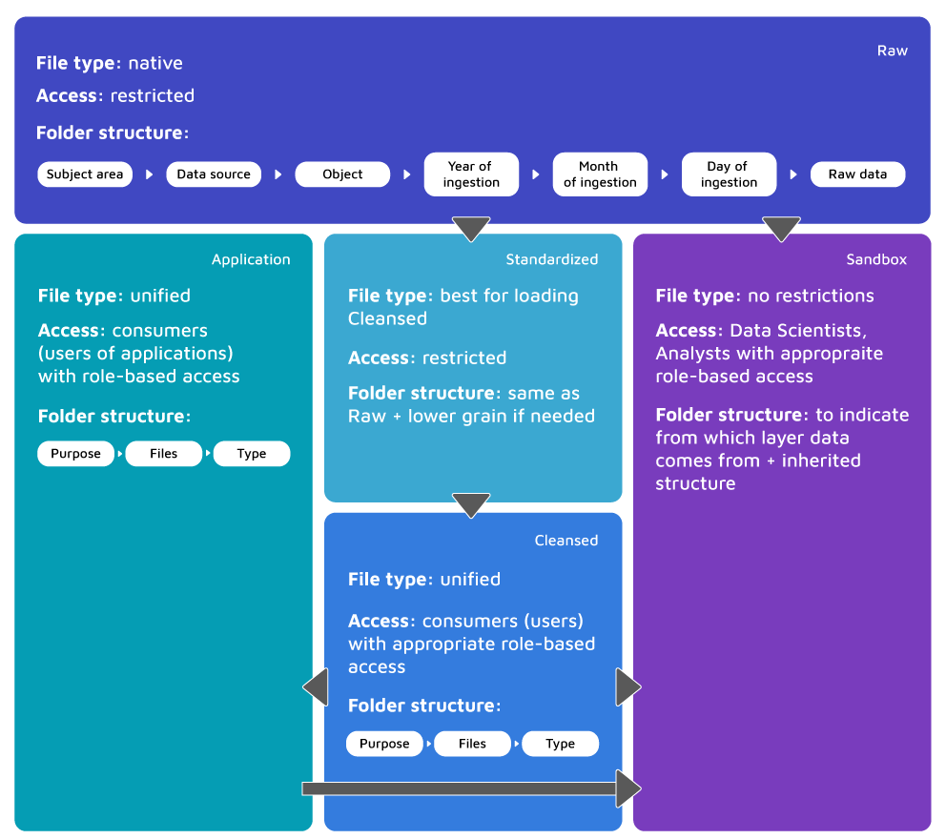
Data Lake Layers
Notes:
Unified file types like pdf, mp3 etc are supported across the different platforms.
Purpose: sale data, files in pdf and csv type

Slide 17
Data Lake Architecture : Layers
Raw data layer
Also called the Ingestion Layer/Landing Area
Main objective is to ingest data into Raw as quickly and as efficiently as possible
Data remains in native format, no transformations are applied
No overriding allowed : Duplicates and versions needs to be handled
Raw needs to be arranged in the folders
Data here is not ready to be used, it requires a lot of knowledge in terms of appropriate and relevant consumption

Slide 18
Data Lake Architecture : Layers
Standardized data layer
may be considered as optional in most implementations
Main objective is to improve performance in data transfer from Raw to Curated
Both daily transformations and on-demand loads are
included
Format is chosen which fits best for cleansing
Structure same as Raw but may be partitioned to lower
grain if needed

Slide 19
Data Lake Architecture : Layers
Cleansed data layer
Also called Curated Layer/Conformed Layer
Data is transformed into consumable data sets and it may be stored in files or tables
Purpose and structure of data is already known which is cleansed and transformed
Denormalization and consolidation of different objects is common
Most complex part of the whole Data Lake solution
Usually, end users are granted access only to this layer

Slide 20
Data Lake Architecture : Layers
Application data layer
Also called Trusted Layer/Secure Layer/Production Layer
Sourced from Cleansed data Layer and enforced with any needed business logic
Anything specific to the application; like row level security, surrogate keys shared among applications, machine learning models calculated on Data Lake etc.; will need this layer
The structure of the data remains the same, as in Cleansed

Slide 21
Data Lake Architecture : Layers
Sandbox data layer
Another layer that might be considered optional
Meant for advanced analysts’ and data scientists’ work
Experiments can be carried out for searching patterns or correlations
For any source from internet enriching the data, Sandbox is the proper place

Slide 22
Data Lake Architecture
Key Components
Security
Governance
Metadata
Stewardship
Master Data
Archive
Offload
Monitoring/Orchestration and ELT Processes

Slide 23
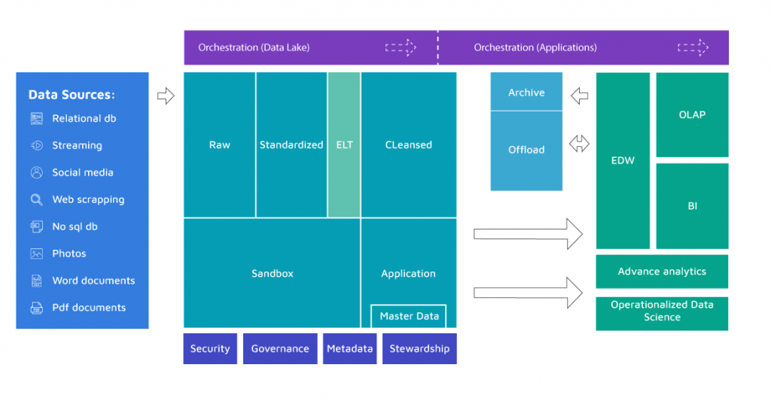
Data Lake Architecture

Slide 24
Data Lake Architecture : Components
Security
Important aspect even though not exposed to broad audience, especially during the initial phase and architecting
Not like relational databases, with an artillery of security mechanisms
Governance
Monitoring and logging (or lineage) operations will become crucial at some point for measuring performance and adjusting the Data Lake

Slide 25
Data Lake Architecture : Components
Metadata
all the schemas, reload intervals, additional descriptions of the purpose of data, with descriptions on how it is meant to be used
Stewardship
Depending the scale of need responsibility is delegated either to separate teams of owners(users)
Master Data
An essential part of serving ready-to-use data
Either store it in Data Lake or reference it while executing ELT processes

Slide 26
Data Lake Architecture : Components
Archive
Data Lakes are often used to keep some archive data that comes originally from DWH
might face some performance and storage related problems if there is relational DWH solution
Offload
In case there is DWH solution, Offload might be used in order to offload some time/resource consuming ETL processes to your Data Lake, which might be cheaper and faster

Slide 27
Data Lake Architecture : Components
Monitoring/Orchestration and ELT Processes
Tool is needed for orchestration of flow as data is being pushed from Raw to Sandbox and Application layers
Tools or some additional resources for the transformation

Slide 28
consider an example of a data lake implementation for a fictional e-commerce company called "E-CommerceX.“
E-CommerceX operates a large online marketplace where customers can purchase a wide range of products, including electronics, clothing, home goods, and more.
The company collects various types of data from its operations, including:
Transaction data: Information about purchases made by customers, including product details, prices, quantities, and payment methods.
Customer data: Details about customers, such as demographics, contact information, purchase history, and browsing behavior.
Website analytics: Data on website traffic, user interactions, clickstream behavior, page views, bounce rates, and conversion rates.
Notes:
Traditionally, each of these data sources might be stored in separate databases or systems optimized for specific purposes. For example, transaction data might be stored in a relational database for efficient querying, while website analytics might be stored in a NoSQL database for flexibility and scalability.

Slide 29
Product data: Information about product catalogs, including product names, descriptions, categories, and attributes.
Inventory data: Details about available inventory, stock levels, replenishment schedules, and supplier information.
Marketing data: Insights from marketing campaigns, including ad impressions, clicks, conversions, and ROI metrics.
Reviews and feedback: Customer reviews, ratings, feedback, and sentiment analysis from social media platforms or review websites.
To leverage this data effectively for business insights and decision-making, E-CommerceX decides to implement a data lake architecture using cloud-based storage and processing technologies.

Slide 30
Here's how the data lake is set up:
Storage: E-CommerceX leverages a cloud-based storage solution, such as Amazon S3 or Google Cloud Storage, to store its raw data in its native format. Each type of data (transaction, customer, website analytics, etc.) is stored in separate folders or buckets within the data lake.
Ingestion: Data pipelines are set up to ingest data from various sources into the data lake. For example, transaction data might be ingested from the company's e-commerce platform database using batch processing, while website analytics data might be streamed in real-time from web server logs using technologies like Apache Kafka.

Slide 31
Schema on Read: The raw data is stored as-is, without any transformation or schema enforcement at write time. Instead, schema enforcement and data processing occur dynamically at query time. This allows flexibility in data exploration and analysis without the need for predefined schemas.
Analytics: Data analysts, data scientists, and business users can access the data lake using a variety of tools and technologies. For SQL-based querying and analysis, tools like Amazon Athena or Google BigQuery can be used. For advanced analytics and machine learning, platforms like Apache Spark or TensorFlow can be integrated with the data lake.

Slide 32
Data Governance and Security: E-CommerceX implements robust data governance policies and access controls to ensure data privacy, security, and compliance with regulations such as general data protection regulation(GDPR). Role-based access control (RBAC) is used to manage permissions, and data encryption is employed to protect sensitive information.
Scalability and Cost Efficiency: The cloud-based data lake architecture offers scalability and cost efficiency, allowing E-CommerceX to store and analyze large volumes of data without upfront infrastructure investments. The pay-as-you-go pricing model ensures that the company only pays for the resources it consumes.
With the data lake in place, E-CommerceX can now perform a wide range of analytics and derive valuable insights from its data. For example:
Data analysts can analyze transaction data to identify trends in customer purchasing behavior and product popularity.
Data scientists can build recommendation models using customer data and product information to personalize recommendations for users.
Marketing teams can analyze website analytics data to optimize marketing campaigns and improve conversion rates.
Operations teams can use inventory data to optimize supply chain management and ensure adequate stock levels.
Overall, the data lake enables E-CommerceX to leverage its data assets more effectively, drive business growth, and deliver a better experience for its customers.

Slide 33
References
https://www.dataversity.net/brief-history-data-lakes/#
https://www.xplenty.com/blog/data-lake-architecture-guide/
https://aws.amazon.com/big-data/datalakes-and-analytics/what-is-a-data-lake/
https://lingarogroup.com/blog/data-lake-architecture/
https://databricks.com/discover/data-lakes/history

